Slide 1

Superstore Sales Performance Insights Dashboard
A data-driven analysis of sales trends, regional patterns, and category performance to optimize your retail operations strategy

Slide 2



Executive Summary
Strong Q4 Growth
Regional Opportunity
Category Balance
Sales consistently rise toward year-end, with September-November peak period driving highest revenue
West Region leads performance; South/North regions present growth potential through targeted strategies
Health Drinks, Soft Drinks, Eggs & Meat, and Snacks drive revenue with balanced distribution reducing dependency risk
Strategic focus should center on maximizing seasonal Q4 revenue, addressing regional gaps, and leveraging high-performing categories for cross-selling opportunities.

Slide 3
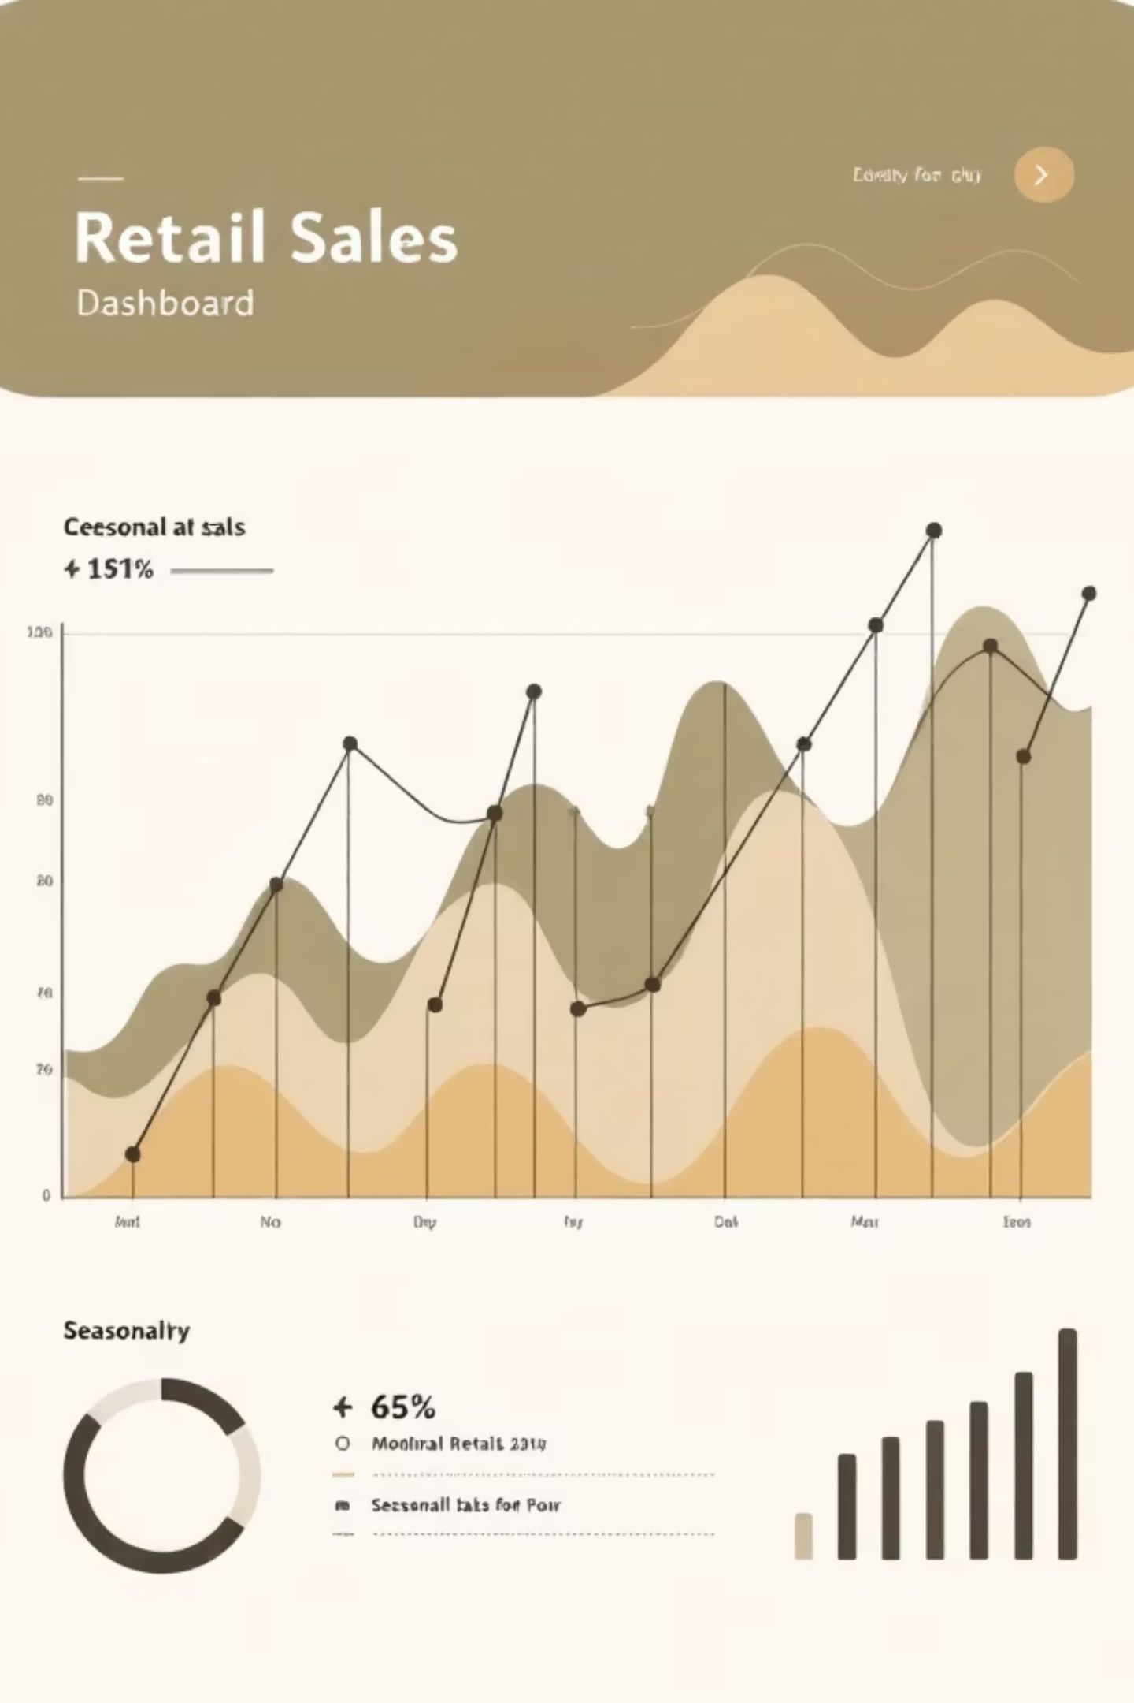
Monthly Sales Trend Analysis
Key Observations
Strategic Implications
Consistent upward trajectory toward Q4 (September–December) across all years
September–November period represents peak revenue window
January–February show lowest performance, indicating Q1 promotional opportunity
Profit margins remain healthy and consistent with sales trends
Seasonal demand patterns are predictable and strong. Retail operations should prepare inventory and staffing levels 60–90 days in advance of peak period.
Q1 underperformance suggests untapped promotional campaigns could accelerate early-year revenue growth.

Slide 4




Monthly Trend: Strategic Action Plan
Inventory Planning
Stock high-demand SKUs before September to avoid stockouts during peak period
Marketing Amplification
Launch Q4 campaigns 45 days prior to maximize reach during seasonal surge
Q1 Promotion
Develop January-February campaigns to address low-performance months and build momentum

Slide 5


Regional Performance Breakdown
Performance Rankings
Opportunity Analysis
Regional performance gap indicates significant market penetration opportunity. Underperforming regions likely face competitive pressures or brand awareness challenges.
West Region: Top performer with highest total sales
East & Central: Stable, moderate contribution
South & North: Underperforming, require growth strategy
Targeted local marketing, community partnerships, and regional promotions can address performance gaps.

Slide 6




Regional Strategy Implementation
Promotional Investment
Market Research
Allocate 20–30% of marketing budget to targeted regional campaigns with localized messaging
Conduct competitive analysis and customer surveys in South/North regions to identify barriers to purchase
Performance Tracking
Community Engagement
Monitor regional metrics weekly and adjust tactics based on response rates and sales lift
Partner with local organizations and events to build brand awareness and customer loyalty in underperforming zones

Slide 7








Category Performance Insights
Health Drinks
Soft Drinks
Leading category with 16% revenue share, strong growth potential in wellness segment
15% revenue contribution, consistent demand with seasonal spikes during warmer months
Snacks
Eggs & Meat
13% contribution, impulse purchase driver with cross-selling opportunities at checkout
14% share, essential category with stable weekly purchase patterns and high basket frequency

Slide 8

Category Optimization Strategy
Bundling Strategy
Pair high-performing categories (Health Drinks, Soft Drinks) with low-performing ones to increase basket size and introduce new products
Strategic Placement
Position Eggs & Meat and Snacks near high-traffic areas to drive impulse purchases and complement main grocery hauls
Promotional Rotation
Feature different high-revenue categories weekly to maintain customer interest and prevent promotional fatigue

Slide 9
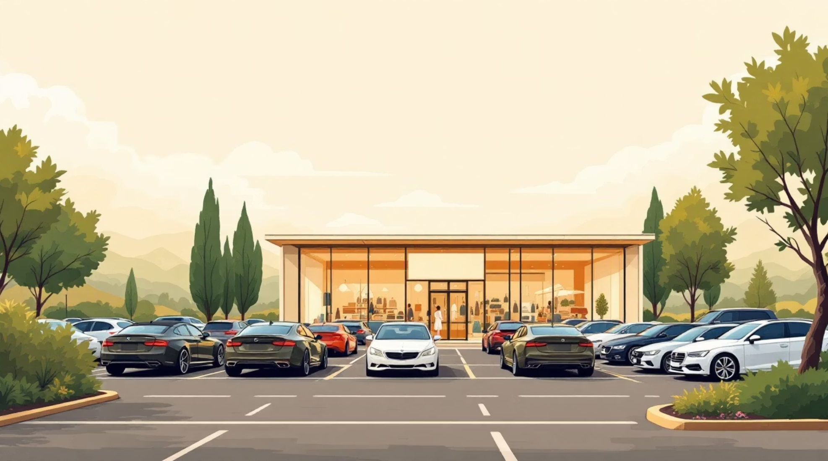
Weekday Sales Pattern Analysis
01
Weekend Surge
Saturday and Sunday show strongest performance as families complete weekly grocery shopping
02
Tuesday Strength
Midweek peak likely from weekday shoppers avoiding weekend crowds and restocking needs
03
Midweek Dip
Thursday and Friday show lower sales as customers anticipate weekend shopping or complete purchases earlier
Pattern Significance
Weekday patterns reveal strong weekend shopping behavior. Low-performing weekdays represent opportunity to balance demand and optimize staffing.

Slide 10

Weekday Strategy: Flash Deal Program
1
Target Thursday & Friday
Launch limited-time flash deals on these days to stimulate midweek traffic and reduce weekend congestion
2
Exclusive Offers
Create Thursday/Friday-only promotions with 15–20% discounts on select categories to drive weekday visits
3
Communication Plan
Promote deals through email, SMS, and in-store signage 48 hours in advance to build anticipation
4
Measure & Optimize
Track redemption rates and basket sizes weekly, adjusting offers based on response and margin impact
Flash deals on low-performing weekdays can increase midweek revenue by 25–35% while building consistent traffic patterns.

